Slide 1

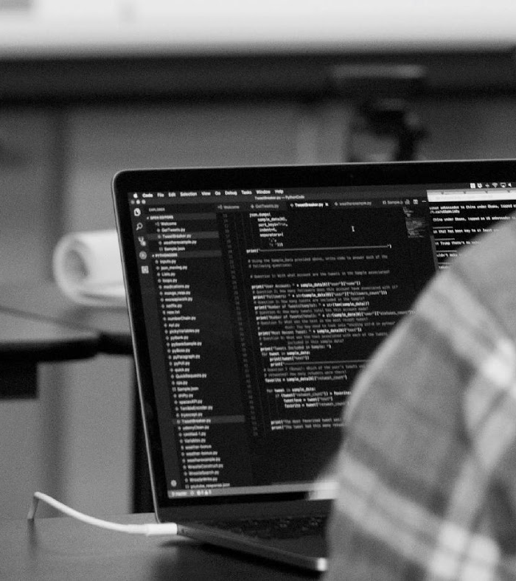

Tackling the Technical Interview Series:
Box Model
Please mark your attendance with an X on the sheet so that you can get credit for this workshop

Slide 2
Purpose & Objectives
Define the Box Model and understand how to utilize it when creating websites.
Organize a set of boxes based off of Box Model principals and positioning.
Define inline block & block.
Answer definition based technical interview questions.

Slide 3

Q&A Style Interview
Notes:
We talk a lot about Whiteboarding and Pair Programming but sometimes in the technical Interview someone will ask you a question and you are just going to have to know the answer. This happens a lot during the HTML & CSS portion of the Technical Interview.
So what should you do if you don’t know the answer to the question?
Ask questions about the question: This will help you stall and think about whats being asked of you in different ways.
What does the principal or topic they are asking you about remind you of? Sometimes its okay to think of what the word sounds like and make an educated guess based off of that.
Try and give an example of when you were working of CSS code, and how this could apply. Sometimes when we start talking about code it’s very easy to connect what we were doing to the question itself.
Try and avoid “I don’t know answers” but it’s okay to tell the Technical Interviewer that you haven’t worked with this yet. Remember it’s not about whether or not you get the question right or wrong, it’s about how well you did compared to other candidates. Honesty goes a long way. The Recruiter will trust you more if you are honest about your skill level but make sure that this is the last strategy you try. Give yourself the opportunity to get the answer right. You never know you might surprise yourself!

Slide 4
Tackling Q&A
So what should you do if you don’t know the answer to the question?
Ask questions about the question: This will help you stall and think about what's being asked of you in different ways.
What does the principal or topic they are asking you about remind you of? Sometimes it's okay to think of what the word sounds like and make an educated guess based off of that.
Give an Example: How could this apply to the code that you’ve been working on? Sometimes when we start talking about code it’s very easy to connect what we were doing to the question itself.
Try and avoid “I don’t know answers”: but it’s okay to tell the Technical Interviewer that you haven’t worked with this yet. Remember it’s not about whether or not you get the question right or wrong, it’s about how well you did compared to other candidates. Honesty goes a long way. The Recruiter will trust you more if you are honest about your skill level but make sure that this is the last strategy you try. Give yourself the opportunity to get the answer right. You never know you might surprise yourself!
Notes:
We talk a lot about Whiteboarding and Pair Programming but sometimes in the technical Interview someone will ask you a question and you are just going to have to know the answer. This happens a lot during the HTML & CSS portion of the Technical Interview.
So what should you do if you don’t know the answer to the question?
Ask questions about the question: This will help you stall and think about whats being asked of you in different ways.
What does the principal or topic they are asking you about remind you of? Sometimes its okay to think of what the word sounds like and make an educated guess based off of that.
Try and give an example of when you were working of CSS code, and how this could apply. Sometimes when we start talking about code it’s very easy to connect what we were doing to the question itself.
Try and avoid “I don’t know answers” but it’s okay to tell the Technical Interviewer that you haven’t worked with this yet. Remember it’s not about whether or not you get the question right or wrong, it’s about how well you did compared to other candidates. Honesty goes a long way. The Recruiter will trust you more if you are honest about your skill level but make sure that this is the last strategy you try. Give yourself the opportunity to get the answer right. You never know you might surprise yourself!

Slide 5
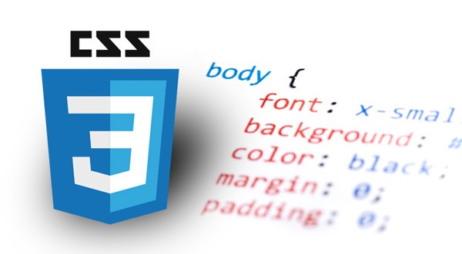
CSS Topics:
Box Model (Review)
CSS Reset Sheet (Q&A Strategy)
Inline, Inline-Block & Block (Review)
Notes:
Dashboard: Go over what is the dashboard, and where everything is on the dashboard.
New Button: Go over the new button and how you make a repository and then show the other places where you can make the repository.

Slide 6
The Box Model

Slide 7
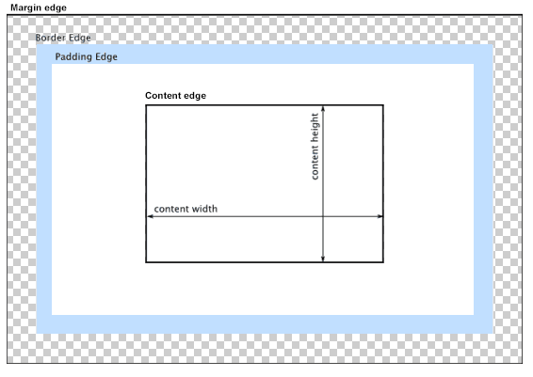

Slide 8
The Box Model
The browser's rendering engine represents each element as a rectangular box according to the standard CSS basic box model. The Box Model has four Parts: the content edge, padding edge, border edge, and margin edge.
Content Area: is surrounded by the content edge and contains any of the materials that go inside of the box. Text, an Image. This is often colored with a background color using CSS.
Padding Area: bounded by the padding edge, extends the content area to include the element's padding. Its dimensions are the padding-box width and the padding-box height. The thickness of the padding is determined by the padding-top, padding-right, padding-bottom, padding-left, and shorthand padding properties.

Slide 9
The Box Model Cont.
Border Area: bounded by the border edge, extends the padding area to include the element's borders. Its dimensions are the border-box width and the border-box height.The thickness of the borders are determined by the border-width and shorthand border properties. If the box-sizing property is set to border-box, the border area's size can be explicitly defined with the width, min-width, max-width, height, min-height, and max-height properties.
Margin Area: bounded by the margin edge, extends the border area to include an empty area used to separate the element from its neighbors. Its dimensions are the margin-box width and the margin-box height. The size of the margin area is determined by the margin-top, margin-right, margin-bottom, margin-left, and shorthand margin properties. When margin collapsing occurs, the margin area is not clearly defined since margins are shared between boxes.
.

Slide 10
QQ: Put Your Answers in the Chat!
Answer one of the following Questions in the Chat
What is the purpose of the Box Model?
How might we use the Box Model to create Websites?
Give an example of a situation you were in where you had to figure out the margin or padding of an element? How did the element change?

Slide 11
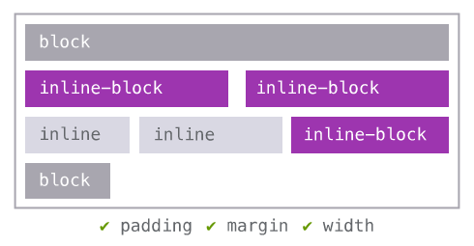
Inline, Inline-Block & Block

Slide 12
Inline, Inline-Block & Block
CSS renders everything as a block.
There are two types of blocks: block & Inline
Block Elements: They always start on new lines and fill up space horizontally. An example of a block element could be a <p> tag or a <div> tag. You can add margins and padding to all four sides of the element.
Inline Elements: Inline Elements do not start on a new line. They appear on the same line as the content tag beside them. Some examples of inline elements are <b>, <i>, <strong>. You can add space to the left and right on an inline element, but you cannot add height to the top or bottom padding or margin of an inline element.
Inline Block Elements: are similar to inline elements, except they can have padding and margins added on all four sides. You’ll have to declare display: inline-block in your CSS code. One common use for using inline-block is creating navigation links horizontally,

Slide 13
QQ: Put Your Answers in the Chat
What is the difference between a block, inline block and inline element?
Give a coding example of when you’ve used an inline block element.

Slide 14
Lets Code

Slide 15


